Slide 1
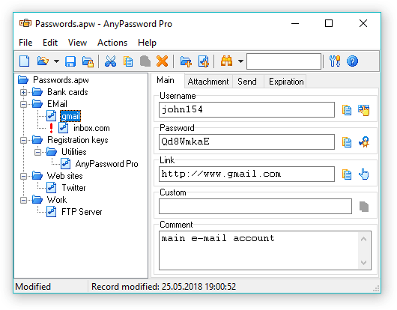
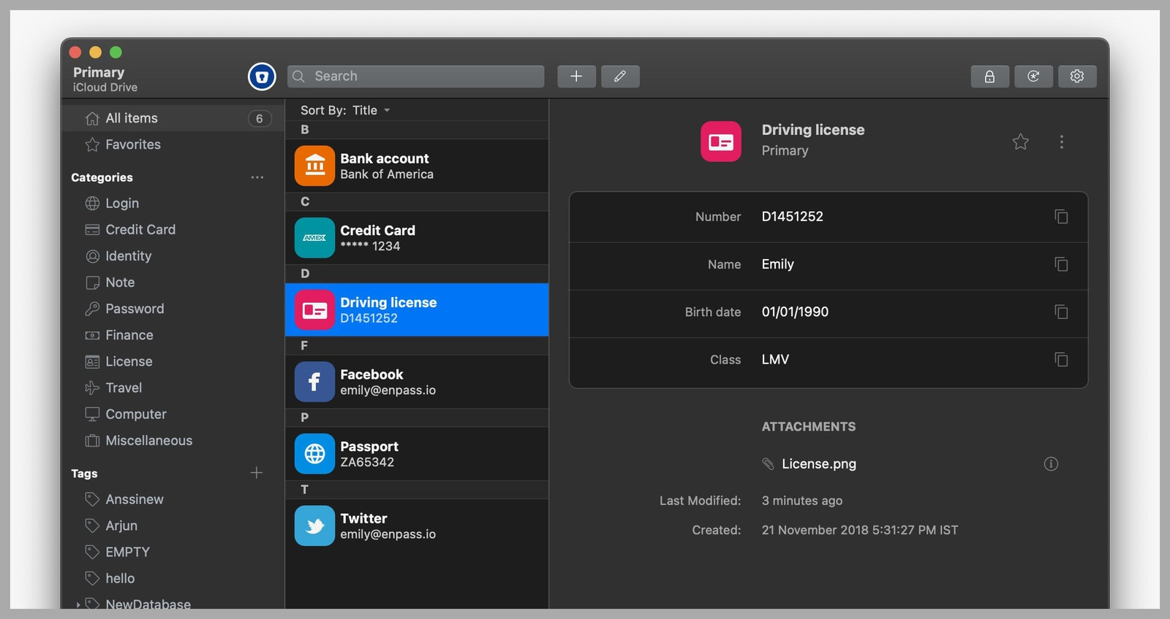
Safe-Keeping
Team Members: Nick Bahr
https://github.com/ksu-is/Safe-Keeping
Safe-Keeping is a software that allows users a secure way to store all their passwords they need

